Slide 1
Indoor Localization System
IOT analytics
Outline:
Objective
Description of data, processes and methods used
Results
Recommendations
Luca Vehbiu | 28/01/2019

Slide 2
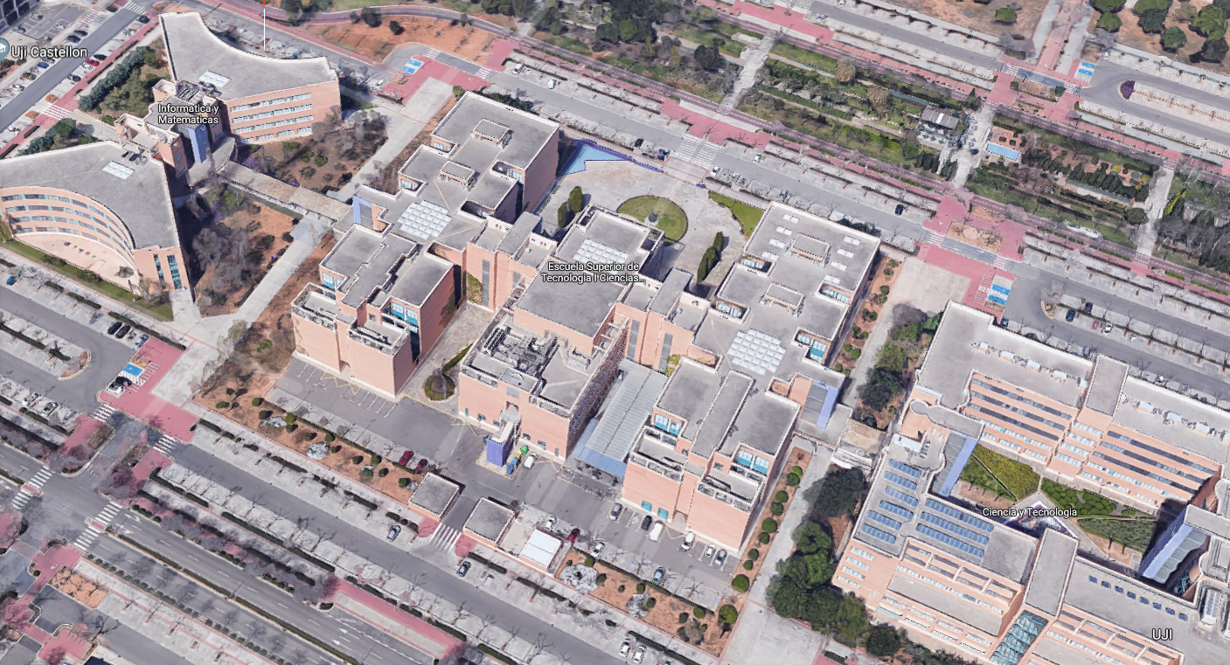
Helping people navigate an unfamiliar and complex interior space
University Jaume I – 110.000 m²

Slide 3



Triangulation of Wi-fi signals
WAP001
-100 dBm

Slide 4

Triangulation of Wi-fi signals
WAP001
?
WAP003

Slide 5
Triangulation of Wi-fi signals
WAP001
WAP002
-92 dBm
-100 dBm
-84 dBm
WAP003

Slide 6
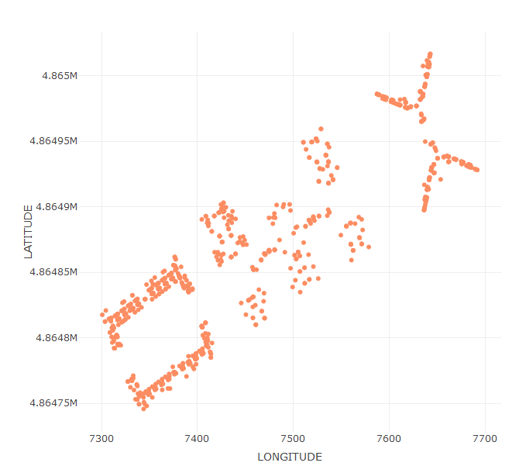
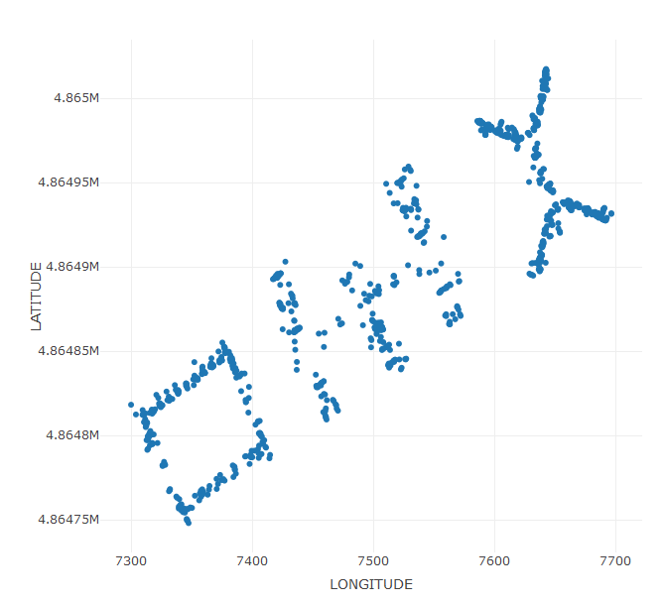
Fingerprint System
Detailed radio-map → Model building
Calibration phase
Map comparison, applied model → Model testing
Validation phase

Slide 7
Fingerprint System
Training set – 19937 observations and 529 variables
Calibration phase
Validation set – 1111 observations and 524 variables
Validation phase
Training set – 19937 observations and 529 variables
Calibration phase

Slide 8
Pre-processing

Slide 9
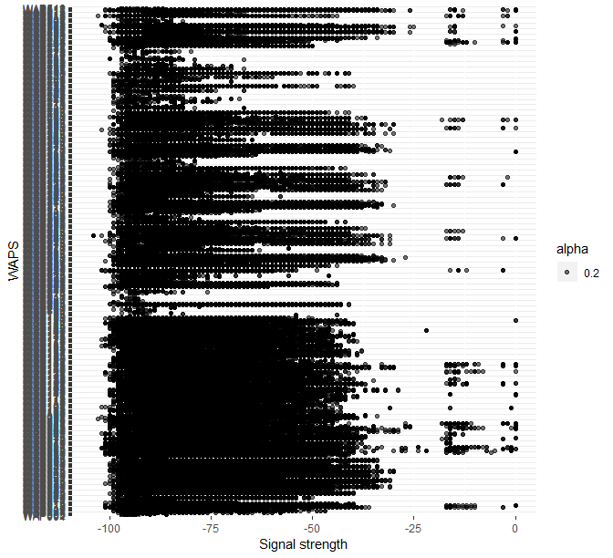
Filter out the unlikely Wi-fi signals

Slide 11
Remove zero variance WAPS
Difference in active WAPS between sets
Unaccounted changes which hurt model performance
Out of 520 WAPS:
Training set - 55 WAPS
Validate set - 153 WAPS

Slide 13
‘Remove the duplicates’, clarify timestamp irregularity
Duplicated coordinates
Weird timestamps (faulty system)
Aggregate by averaging all the signals
Obtain highly accurate signal from a certain coordinate
Multiple captures of same coordinates, with at least 2 phones covering the same spot

Slide 14
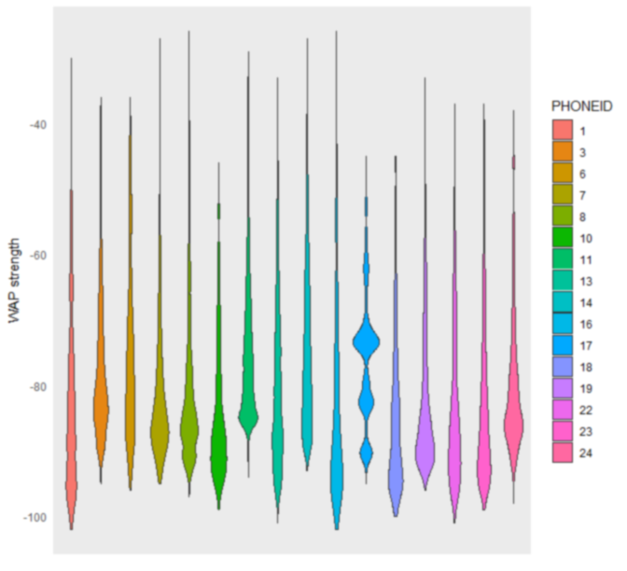
Normalize different phone signal distribution
To not OVERFIT to phone models in the training data!

Slide 15
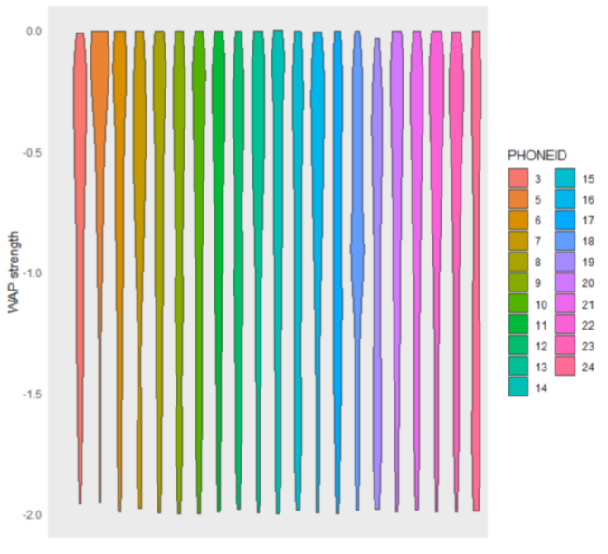

Slide 16
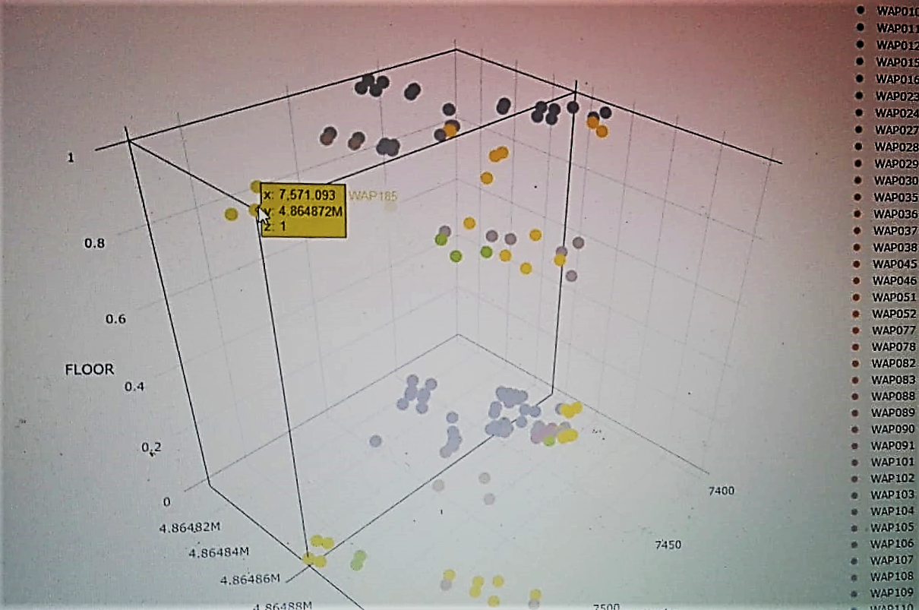
WAP inconsistencies
Building 1, Floor 0 & 1
12 Irregular WAPS
9 Overlapping WAPS
293 WAPS used in the end

Slide 17
Modelling

Slide 18
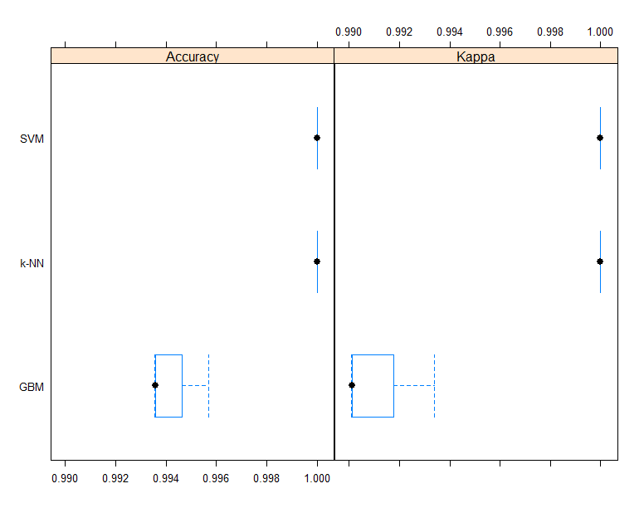
Classifying buildings

Slide 19
Modelling workflow
Floor classification
Building 1
Predict Building
Building 2
Building 3
Lat/Long Regression

Slide 20
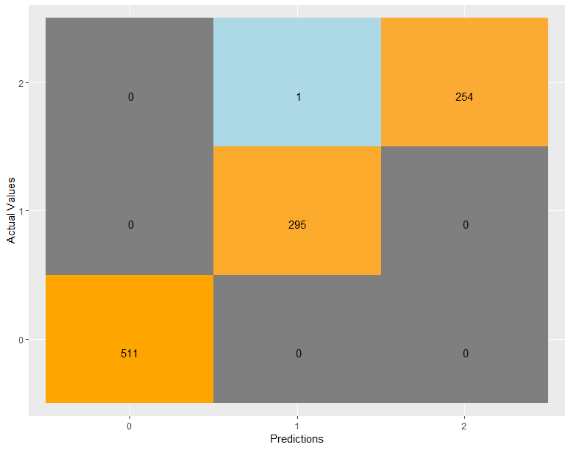
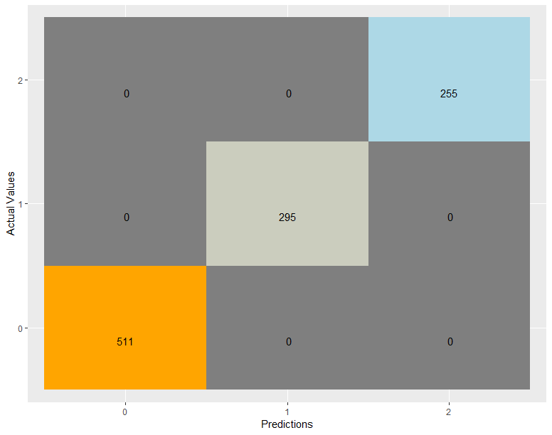
SVM Linear
k-NN (1)

Slide 21
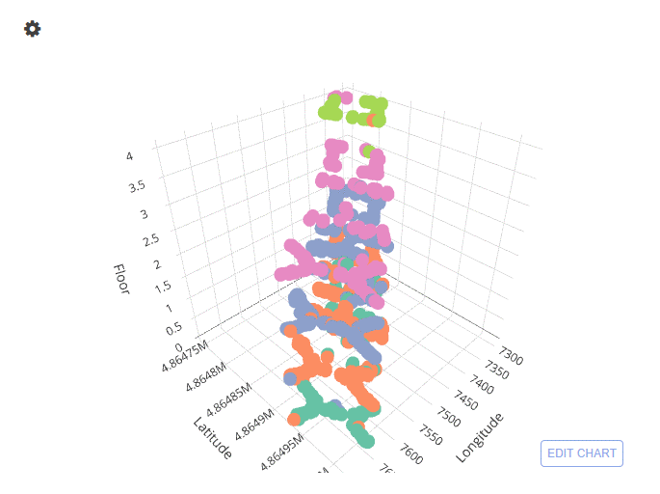
Floor Classification(overall model)
Against validation set
Acc: 0.942 Kappa: 0.92

Slide 22
Classifying FLOORS through predicted Buildings
Building ID | Accuracy | Kappa
Floors of Building 0 | 0.96 | 0.95
Floors of Building 1 | 0.92 | 0.88
Floors of Building 2 | 0.96 | 0.94

Slide 23
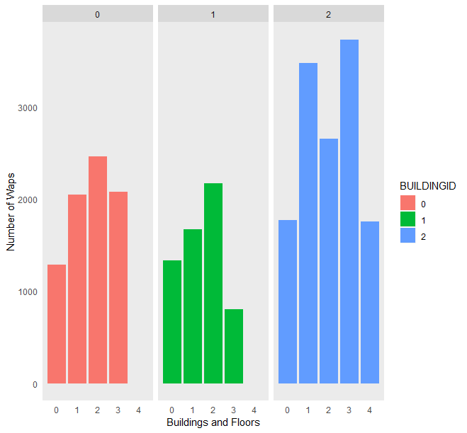
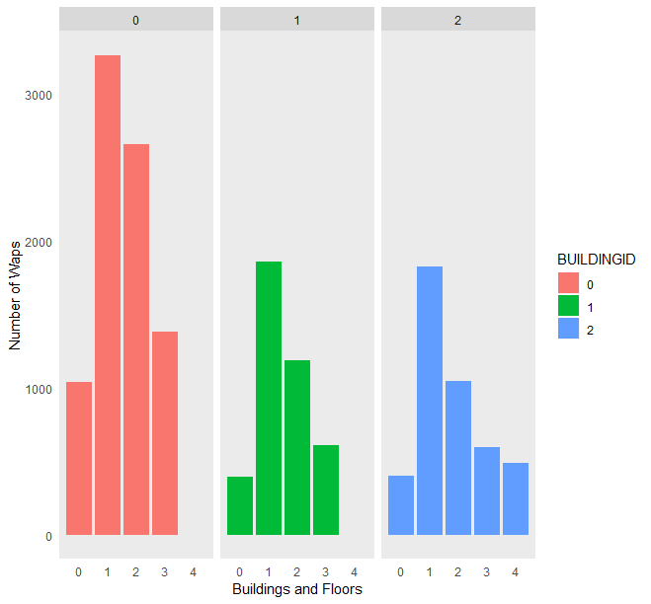
Training set
Validation set

Slide 24
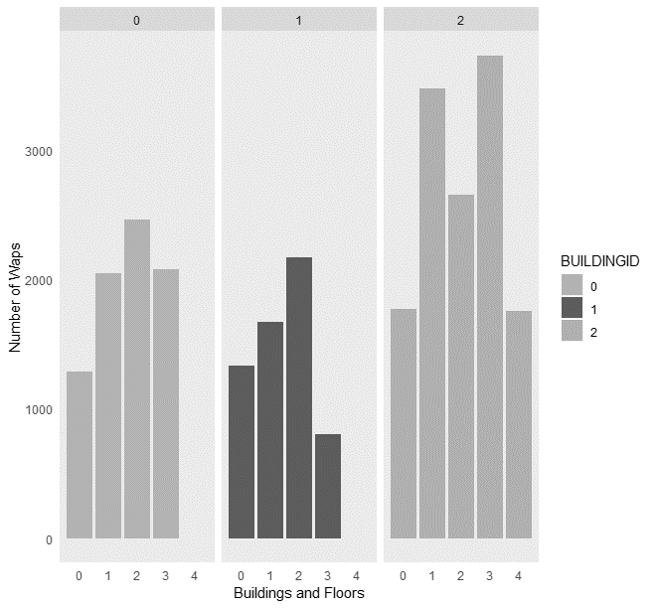
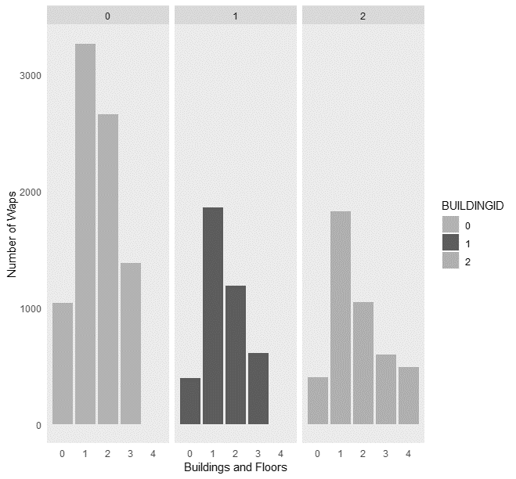
Training set
Validation set
Number of active WAPS

Slide 25
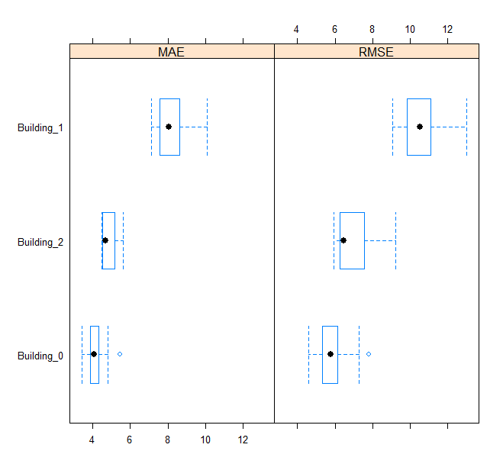
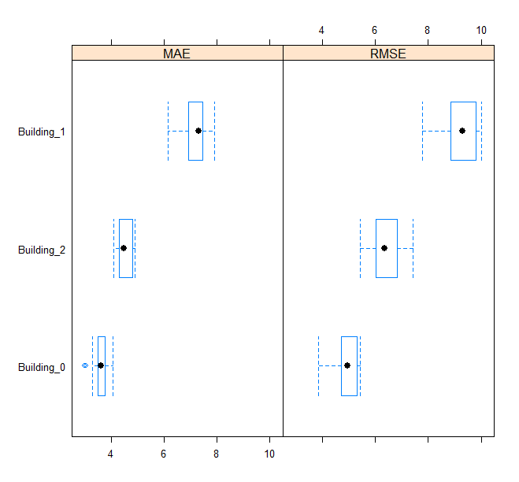
LONG/LAT – k-NN (3/2)
Longitude | RSME | MAE
Training | 7.92 m² | 5.75 m²
Validation | 8.06 m² | 5.20 m²
Overall
Latitude | RSME | MAE
Training | 7.05 m² | 5.05 m²
Validation | 7.07 m² | 4.62 m²
Per Building

Slide 26
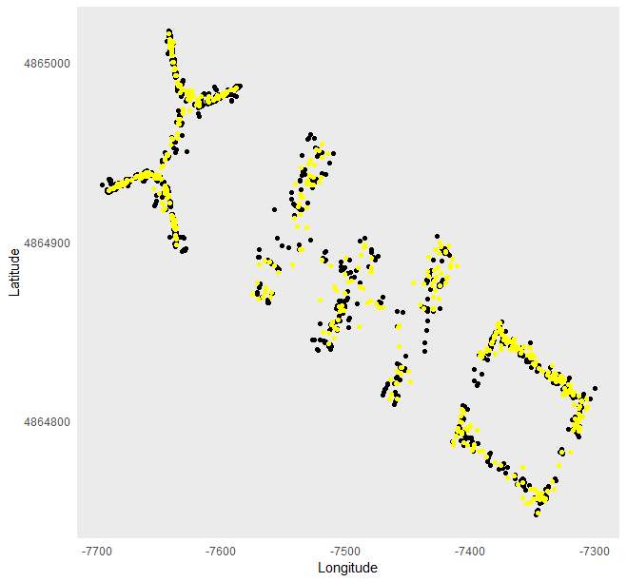
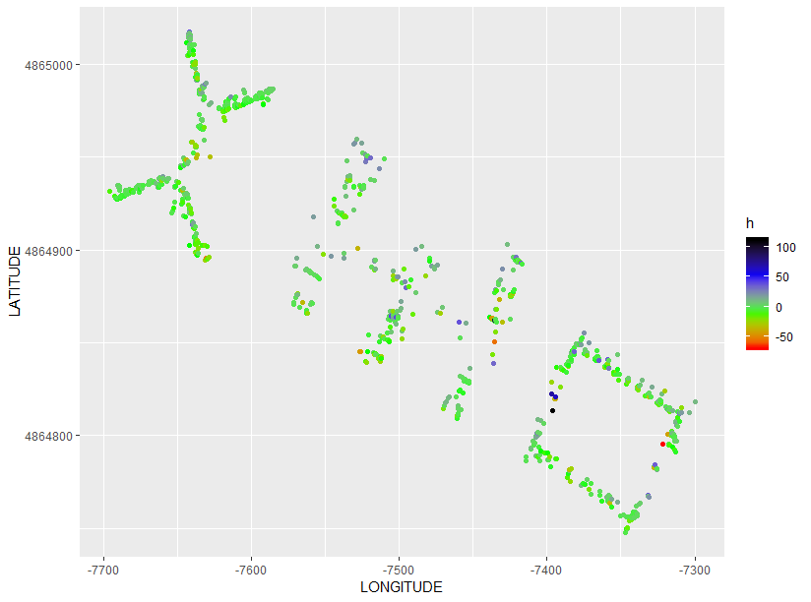
Predicted Long/Lat
Error coordinate distance
Actual value
Predictions

Slide 27
Recommendations
Balanced Dataset
Wi-fi device locator
Known location of WAPS
Planimetry, materials

